Slide 1

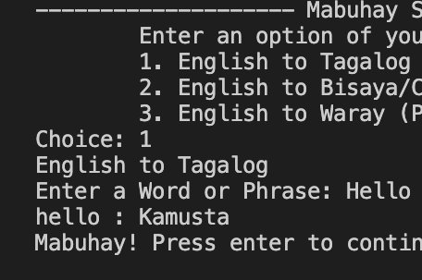
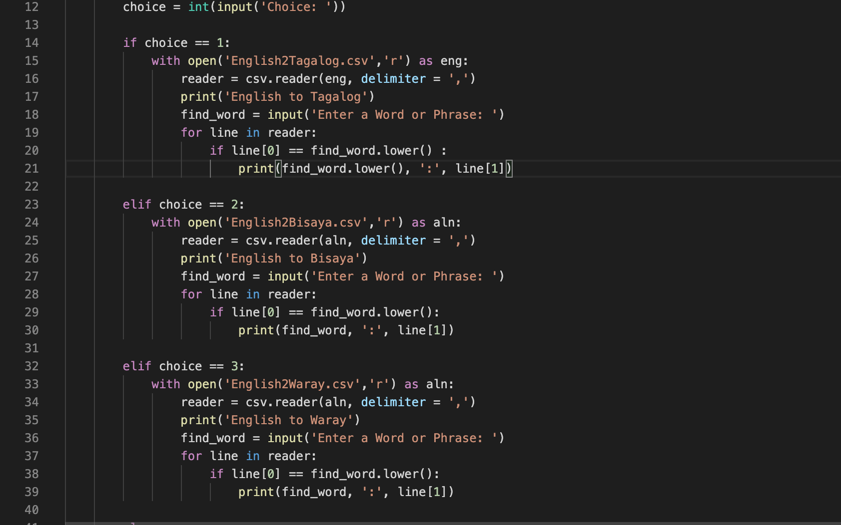

So Filipino
Translates from English to 3 widely spoken dialects in the Philippines
Including Tagalog and Bisaya
A Translator by Ryan Bacarra
https://github.com/ksu-is/So-Filipino-interpreter

